Slide 1

Java EE – EJB – JMS

Slide 2
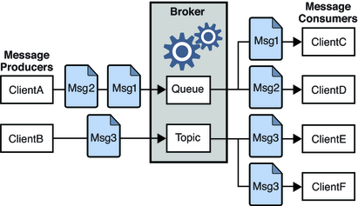
JMS
javax.jms
ConnectionFactory
Message
Queue
Point-to-Point
Topic
Publish/Subscribe

Slide 3
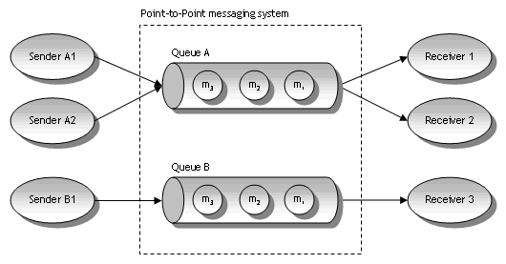
Queue

Slide 4
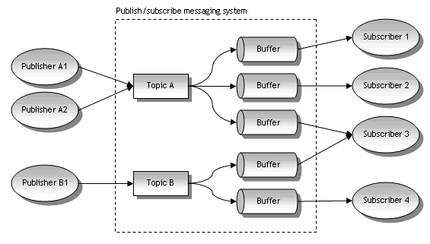
Topic

Slide 5
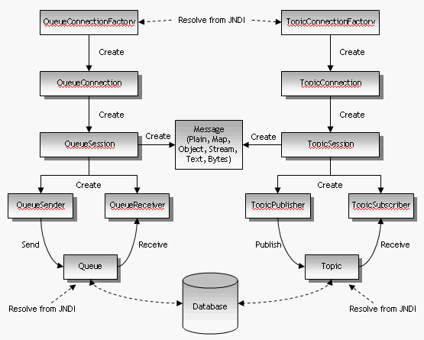
JMS működése

